Slide 1

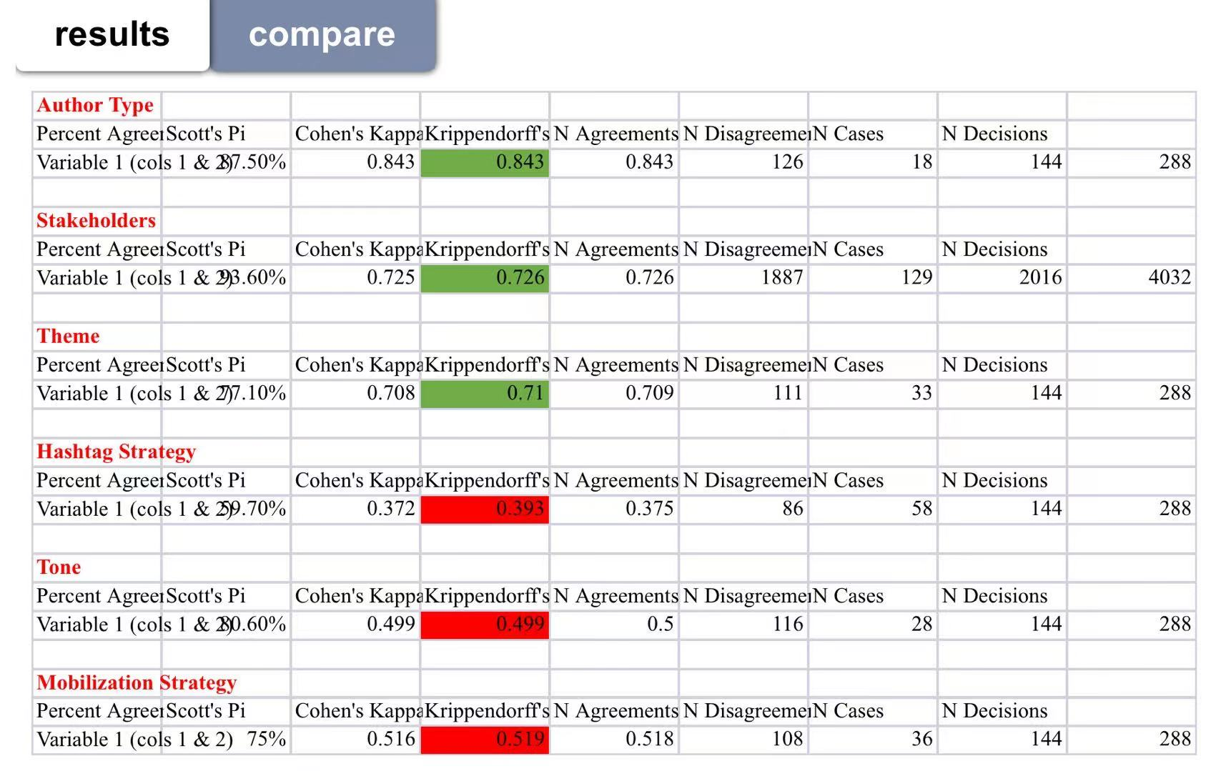
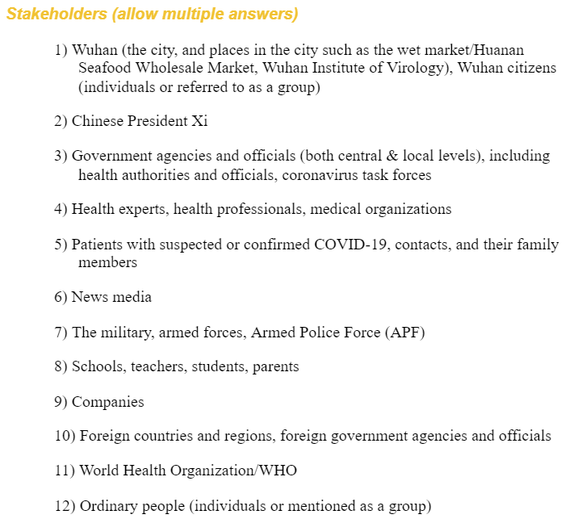
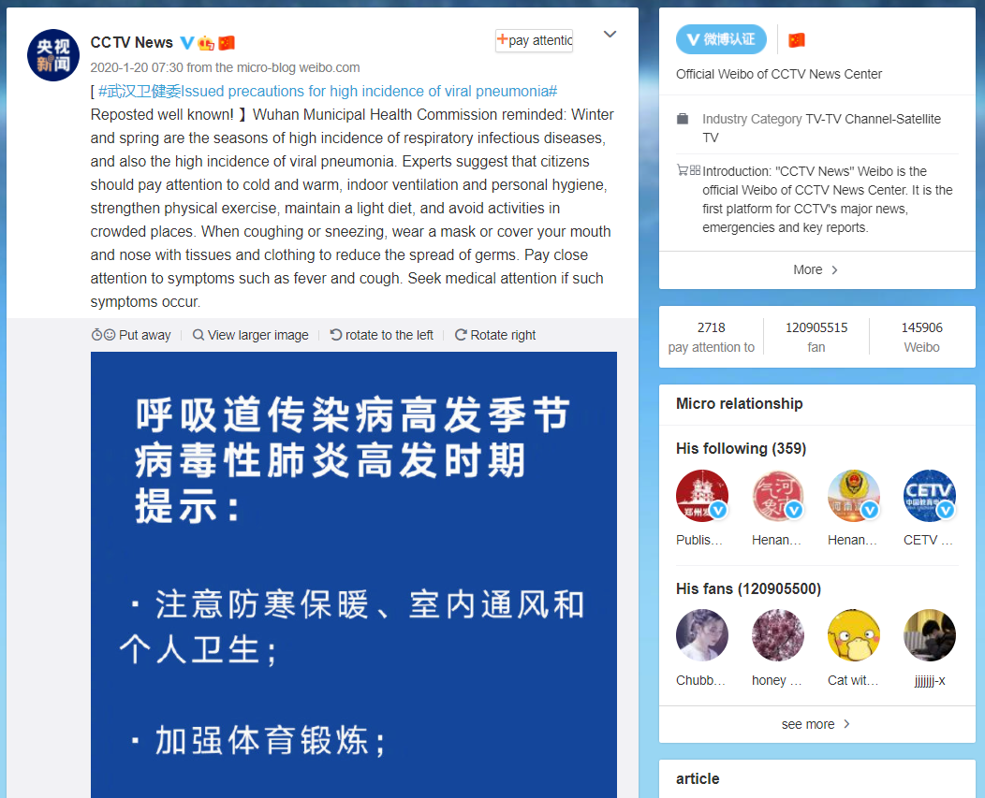
COVID-19-Hot issues and agenda building research
Group member: Xintong Bai, Hanbin Liu
Professor: Alice Cheng(ycheng20@ncsu.edu)
Background
Innovation
Define Weibo as a field of public opinion in the process of social mobilization and agenda building in China
Use social mobilization and agenda building in Chinese context.
Reliability
COVID-19 is raging across the country. President Xi made important instructions on the pneumonia epidemic caused by COVID-19, emphasizing that the safety and health of the people should be put first, and resolutely curb the spread of the epidemic. The World Health Organization announced that the COVID-19 has been listed as a public health emergency of international concern, and the outbreak of the new coronary pneumonia epidemic has constituted a global "pandemic."The Chinese government inspected and guided epidemic prevention and control work, and large-scale cooperation was formed across the country. Various groups express their opinions on the Weibo platform. In the event of public health emergencies, China's public opinion field-Weibo platform deserves our attention.
A
B
C
Methodology
Content analysis
Universe of texts:
posters on Weibo from 1/20/2021 to 1/30/2021
Sampling: randomly sampling
Create code book(example)
Introduction
Social mobilization is the process of bringing together allies to raise awareness of and demand for a particular programme, to assist in the delivery of resources and services and to strengthen community participation for sustainability and self-reliance.
Agenda building is a process ideally suited to comparative analysis, as it is concerned with the way that different groups participate in policy and public opinion formation.
Sina Weibo(referred to as Weibo) is the most popular microblogging website in China. Weibo provides similar functionality to Twitter and Facebook.
Units of analysis: each poster
A.
B

